Slide 1
Review of Audit Readiness Checklist
January 2025
Heather Royer

Slide 2
What is a Self-Audit?
Review of Claims and Billing Records
Evaluation of Documentation
Compliance Check with Medicaid Regulations

Slide 3
What are the goals of a Self-Audit?
Ensure Compliance with Medicaid Rules and Regulations
Identify Errors and Inconsistencies
Protect Medicaid Funding
Improve Operational Processes
Prepare for External Audits

Slide 4
What are the benefits of a Self-Audit?
Proactive Identification of Compliance Issues
Risk Mitigation
Cost Savings
Improved Operational Efficiency
Strengthened Compliance Program
Opportunity to Self-Report
Preparation for External Audits

Slide 5
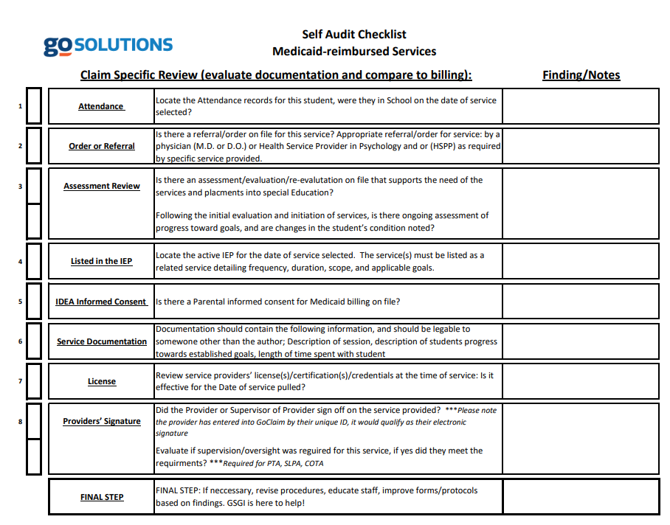
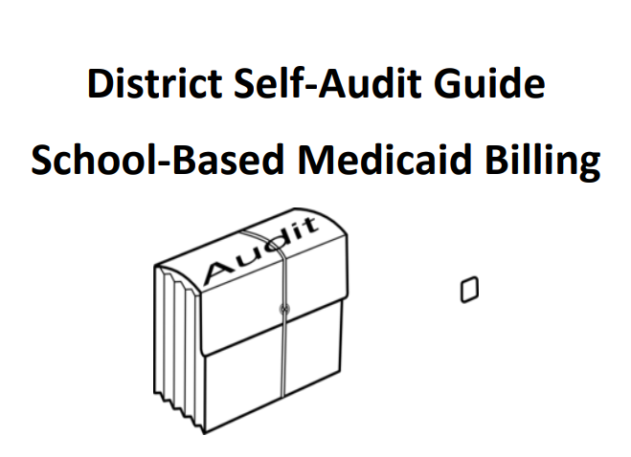
Helpful Resources

Slide 6
Set-up a Self-Audit
Scope
Date Range
Determine “auditor”
Determine team players
Contact Go Solutions Customer Success Manager for random list of claims to be reviewed

Slide 7
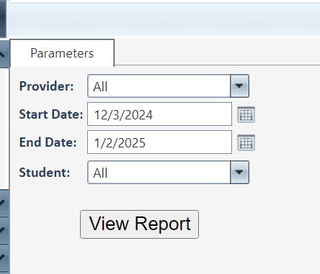
Sample of Services
Reports>Documentation>Service Documentation
Pull a sample service of your choice

Slide 8
Attendance
Student attendance record for DOS
Student Information System
Legend that explains attendance codes
District Calendar
Provider attendance record for DOS
District employee attendance log
District Calendar

Slide 9
Order or Referral
Plan of Care, Order, Referral, Prescription (Script)
Signed by Qualified Medical Provider (QMP) to prove medical necessity
Cover DOS

Slide 10
Assessment Review
Evaluation to prove medical necessity of the services.
Evaluation recommending service?
Evaluation valid for DOS?
Evaluation Signed by Qualified Medical Provider (QMP) to prove medical necessity?

Slide 11
Listed in Billable Plan
Must provide billable plan to cover DOS
Which billable plans are allowable per your state Medicaid plan.
Billable plan must include scope, duration, and frequency of service
The DOS and CPT code used for service must be covered in billable plan

Slide 12
Parental Consent to bill Medicaid
Location – make copy
Annual Notice
Signed prior to service being delivered?

Slide 13
Service Documentation
All Services
Date of Service
Student demographics – DOB and medicaid
Providers – name, title, NPI (if applicable)
CPT code
ICD10 code
Supervisor Signature – if needed
Clinical Notes
Transportation
Driver and/or attendant/aide signature and/or initials

Slide 14
Licensure
Provider license per State Medicaid Plan
Effective date and revalidation date for licensure
NPI number if applicable

Slide 15
Providers Signatures
Signature and date for DOS
Supervisor Signature if needed
Signature on clinical notes if notes are not in GoClaim

Slide 17
Audit Findings Review with Customer Success Manager
Throughout the audit process, keep notes on the Self-Audit Checklist. Any findings should be discussed and considered for void.
If major findings are uncovered during the audits, the district may decide to do a Self-Disclosure of those findings to the state.
Either way – the voided amounts will be deducted from your future Medicaid payments.
Go Solutions is here to help every step of the way!

Slide 18
Final Step
Revise Procedures
Educate and Train Staff
Update forms and protcols
Ask your Customer Success Manager to review and provider more tips

Slide 19
Self Audit Guide

Slide 20
Customer Success Managers
AZ, ID, GA and LA
Erminia Errante erminia.errante@gosolutions.com ​
FL, IL, MI, WI, OH, IA
Jamie Gonzales jamie.gonzales@gosolutions.com ​
IN, MA
Heather Royer- heather.royer@gosolutions.com

